Slide 1
MINOR PROJECT
TOPIC: BIBLIOREAD

Slide 2
ABSTRACT
Books are infinite source of knowledge. Book reading gives us many knowledge about the world and about our surroundings. Everyone likes to read books but their categories are different some likes historical books and some likes romance story ,some others like entertaining and so on…. Peoples used books for acquiring knowledge and for spending time. But the major problem faced by the booklovers and book readers are lack of availability of books in our market and library. Some book readers like to read books online and hear audiobooks. But the availability of these book are very rare. So we have to decide solve the problem faced by the bibliophiles by developing a web portal by connecting all book publishers by providing all books hard copy , soft copy and audiobook availability. Our web portal provides the 3 types of copies of all books

Slide 3
ABSTRACT
Any user can join the web portal by creating an account and register using their details. Mainly three features are added to the web portal. we can search for a book the web portal shows the book’s hardcopy ,softcopy, audiobook .We can buy hard copy of the book as like an store, we will send it to your address and you can download soft copy of the book through online and we will send it through the email use provided. And you can also hear audio book by taking monthly or weekly subscription and users who take the subscription will get a free ebook at weekend of their choice. You can add feedback and reviews about the book. The rating of the book will also display by searching for the book.

Slide 4
ABSTRACT
User can post ratings, comments,feedbacks,reviews about the book and customer service. The administrator will monitor the details and display it to the user through web portal.

Slide 5
MODULE DESCRIPTION
ADMINISTRATOR
a)Verify uploading of new e-books and audiobooks
b)List out new hardcopy booklist
c)Manage user and user rating reviews
d)Manage publishers and their book uploads

Slide 6
MODULE DESCRIPTION
2) PUBLISHER
a)Upload audiobooks,e-books
b)Update Hard copy stock list
c)Verify users review and ratings
d)Verify payment status

Slide 7
MODULE DESCRIPTION
3)USER
a)Registration
b)Payement
c)Post book reviews
d)Add rating to the audiobooks

Slide 8
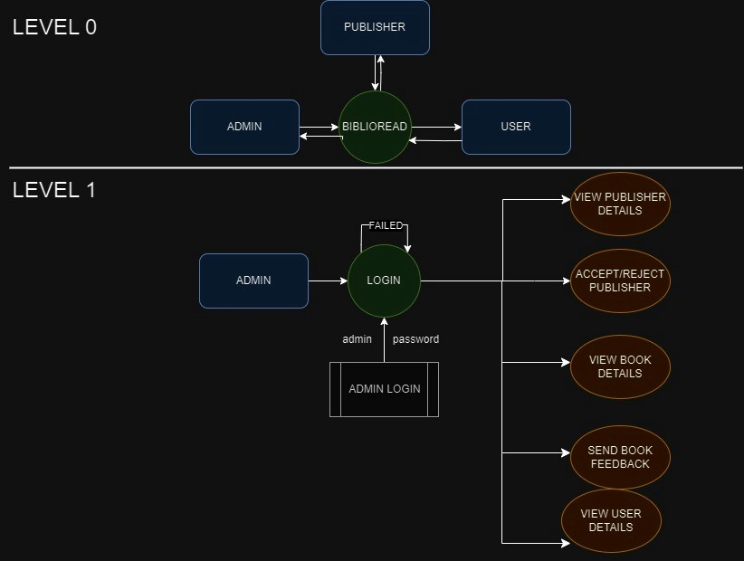
DATA FLOW DIAGRAM OF BIBLIOREAD

Slide 9
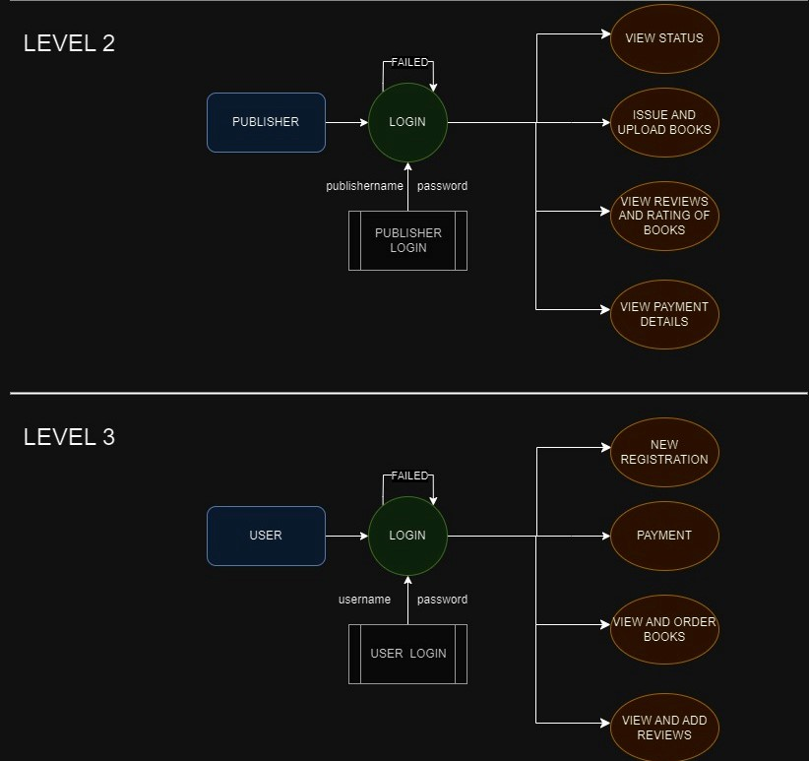
DATA FLOW DIAGRAM OF BIBLIOREAD

Slide 10
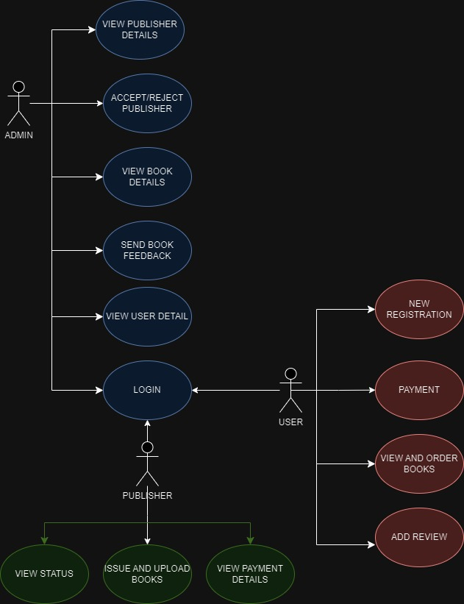
User case diagram OF BIBLIOREAD

Slide 11
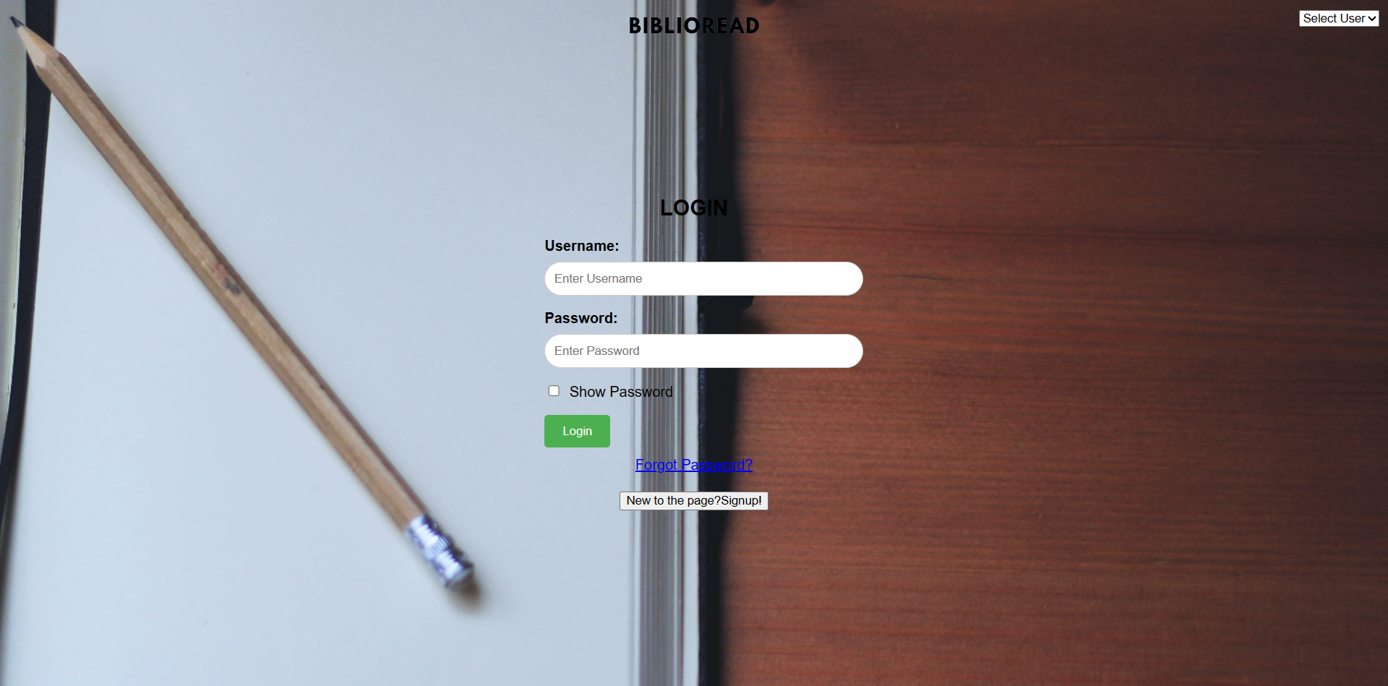
WEB FORMS
L O G I N F O R M S
USER LOGIN

Slide 12

WEB FORMS
L O G I N F O R M S
ADMIN LOGIN

Slide 13

WEB FORMS
L O G I N F O R M S
PUBLISHER LOGIN

Slide 14

WEB FORMS
S I G N U P F O R M S
USER SIGNUP

Slide 15
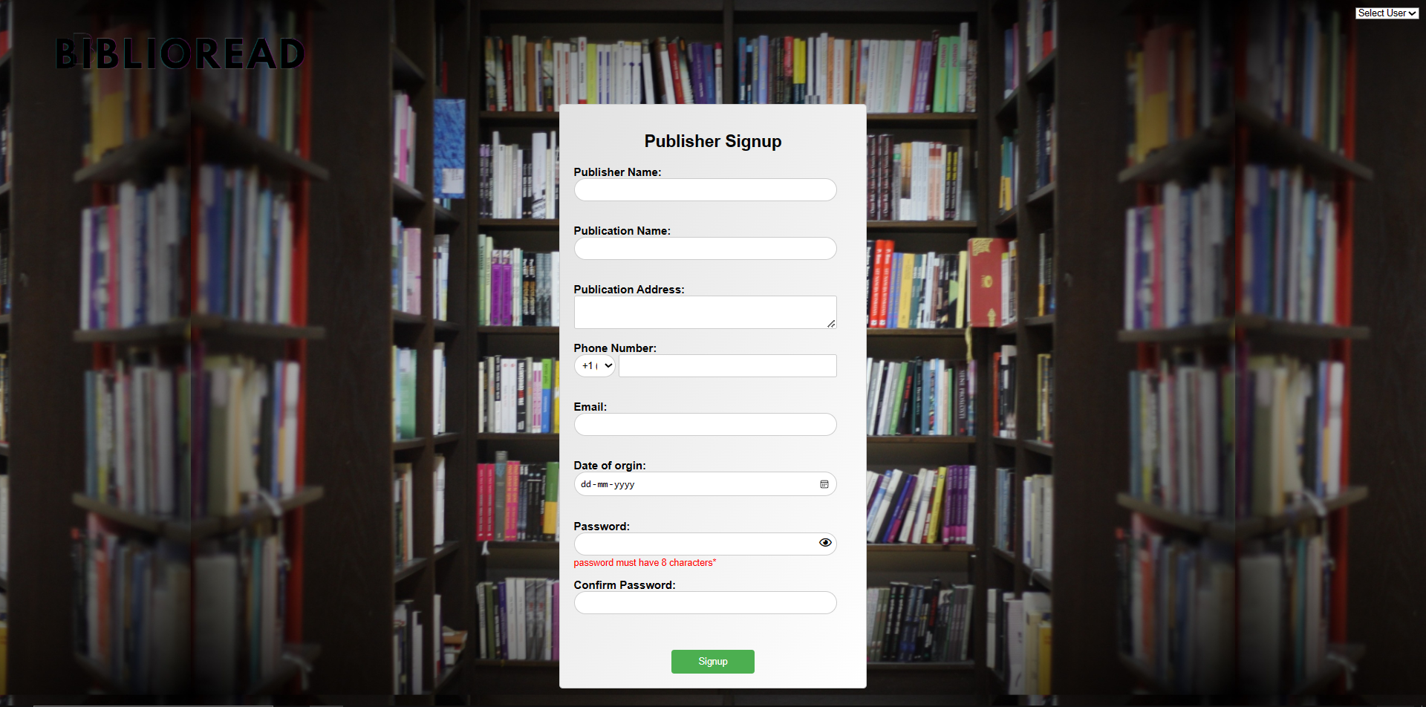
WEB FORMS
S I G N U P F O R M S
PUBLISHER SIGNUP

Slide 16
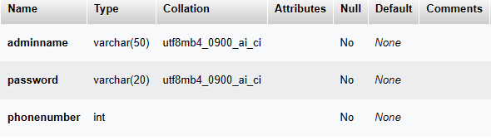
DATABASE
L O G I N T A B L E S
ADMIN LOGIN

Slide 17
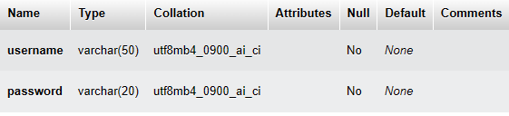
DATABASE
L O G I N T A B L E S
USER LOGIN

Slide 18
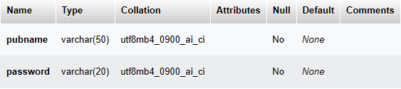
DATABASE
L O G I N T A B L E S
PUBLISHER LOGIN

Slide 19
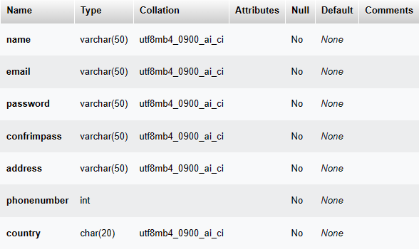
DATABASE
S I G N U P T A B L E S
USER SIGNUP

Slide 20
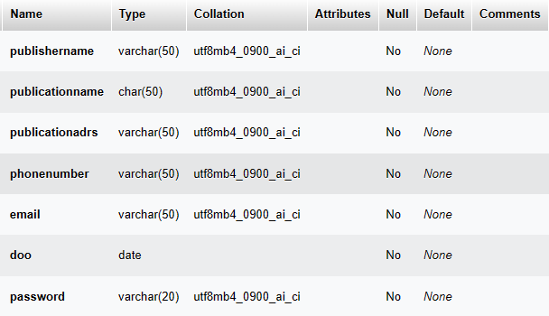
DATABASE
S I G N U P T A B L E S
PUBLISHER SIGNUP

